Slide 1
String Algorithms and Data Structures
- Akshay Dhillon

Slide 2
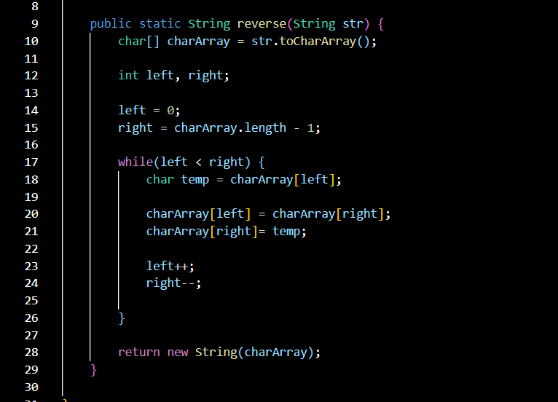
String – Reverse a String
Note: Don’t use built in functions which directly reverses the string
Problem Statement:
Reverse a given String
Input:
“akshay”
Output:
“yahska”
Input:
“abcd”
Output:
“dcba”

